Slide 1
Neural heterogeneity promotes robust learning
Nicolas Perez-Nieves, Vincent C. H. Leung, Pier Luigi Dragotti, Dan F. M. Goodman

Slide 2
Summary
Neural heterogeneity is metabolically efficient for learning, and optimal parameter distribution matches experimental data.

Slide 3
Model
Three layers of spiking neurons: an input layer, a recurrently connected layer (RNNs and biological NNs share several properties, such as a similar general architecture, temporal dynamics, and learning through weight adjustments [Neftci et al , 14]), and a readout layer used to generate predictions.
Heterogeneity was introduced by giving each neuron an individual membrane and synaptic time constant.
The first spike in the output layer will rapidly classify the input signal.

Slide 4
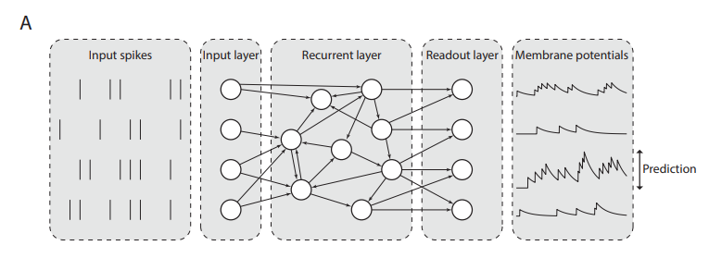
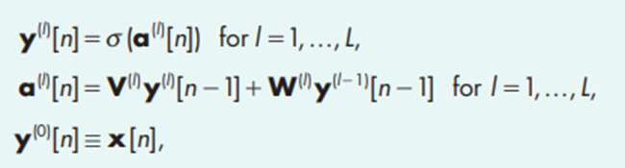
Model

Slide 5
Model
Cases that were studied:
Initial values could be either homogeneous (all synaptic and membrane time constants are initialized to the same value) or heterogeneous (synaptic and membrane time constants are randomly initialized for each neuron by sampling them from a given probability distribution (in this case, a gamma distribution))
Training could be either standard (only the synaptic weights are learned) or heterogeneous (the synaptic weights and membrane and synaptic time constants are learned).

Slide 6
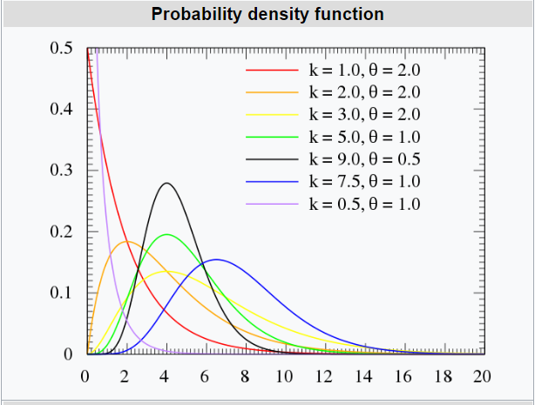

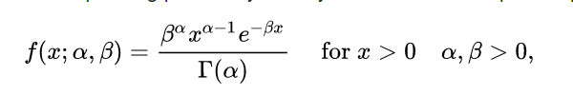
Gamma Distribution
α = k (shape) and β = 1/θ (rate)

Slide 7
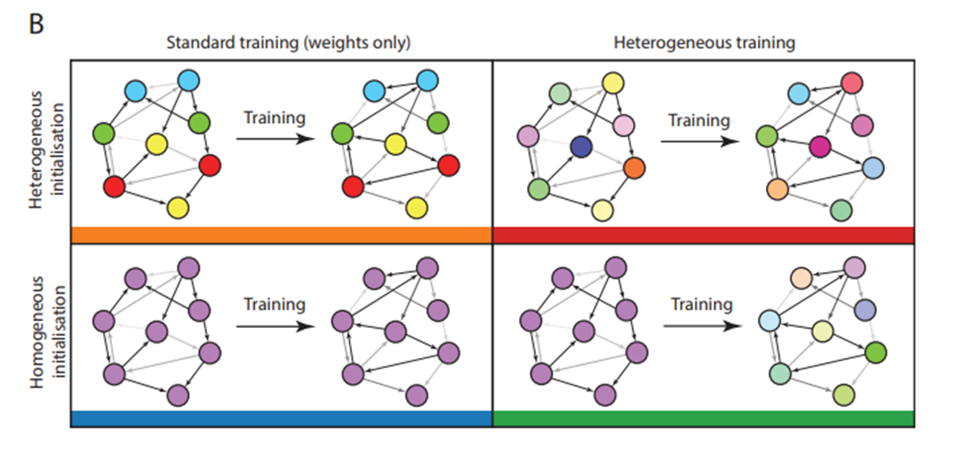
Model
Synaptic weights were plastic (changing during the training), but depending on the training method, the time constants were either held fixed at their initial values (standard training), or could be modified (heterogeneous training regime).

Slide 8
Datasets
Neuromorphic MNIST (N-MNIST) (visual stimuli).
Fashion-MNIST (F-MNIST) (visual stimuli).
DVS128 Gesture dataset (visual stimuli).
the Spiking Heidelberg Digits (SHD) (auditory)
Spiking Speech Commands (SSC) (auditory).

Slide 9
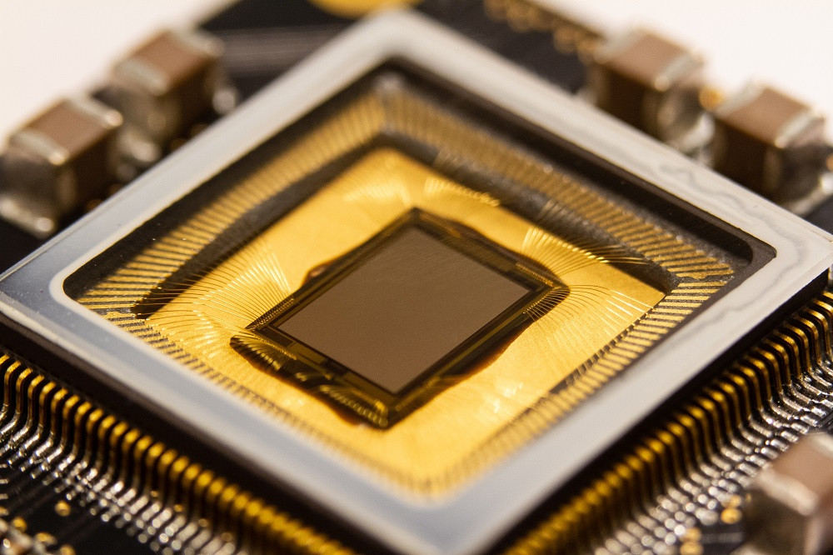
Datasets
N-MNIST: moving the sensor with a static visual image of handwritten digits.
DVS128: recording humans making hand gestures.
Fashion-MNIST (F-MNIST): converted into spike times by treating the image intensities as input currents to model neurons, so that higher intensity pixels would lead to earlier spikes, and lower intensity to later spikes
Used neuromorphic vision sensor to generate spiking activity.

Slide 10
Datasets
SHD
SSC
A detailed model of the activity of bushy cells in the cochlear nucleus, in response to spoken digits (SHD) or commands (SSC).

Slide 11
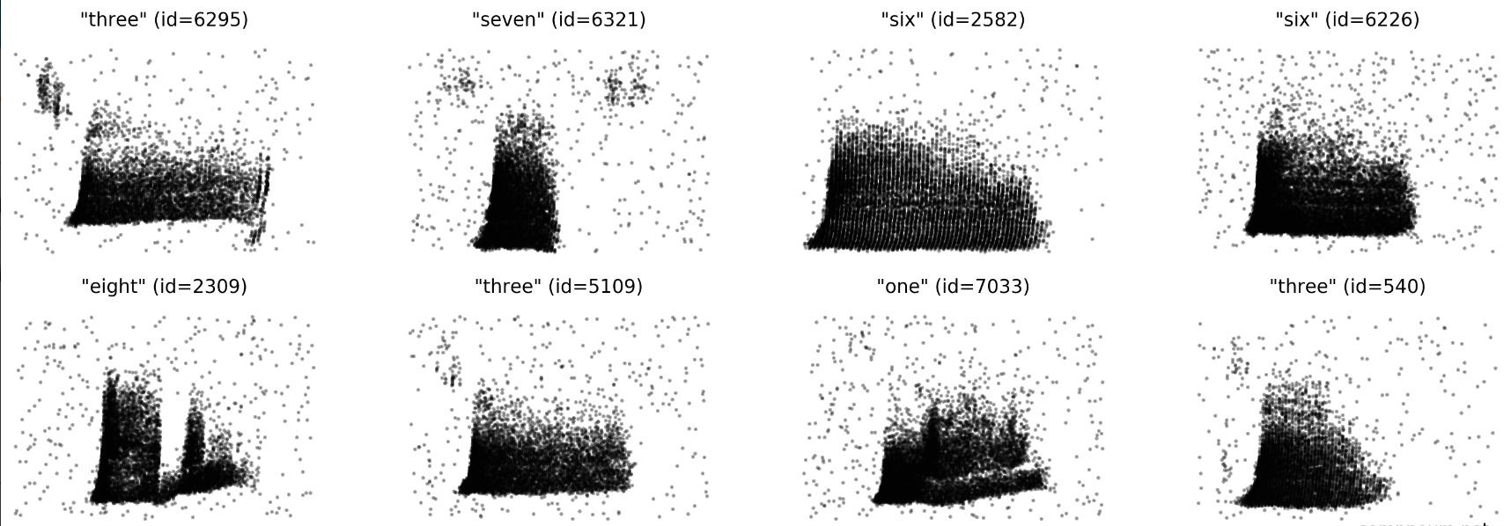
Dataset – SHD

Slide 12
Results

Slide 13
Time scale heterogeneity improves learning on tasks with rich temporal structure
The auditory tasks SHD and SSC by contrast have very rich temporal structure (accuracy improved by a factor of around 15-20%).
N-MNIST and F-MNIST have minimal temporal structure, as they are generated from static images (no improvement at all).
DVS128 has some temporal structure as it is recorded motion, but it is possible to perform well at this task by discarding the temporal information (intermediate improvement, heterogeneous models being better able to distinguish between spatially similar but temporally different gestures).

Slide 14
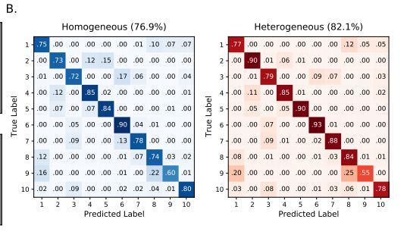
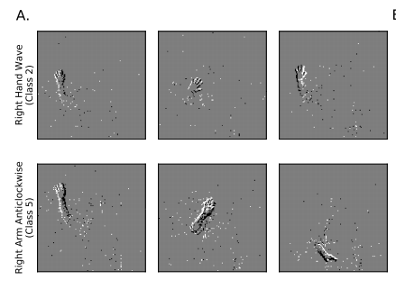
Confusion matrices of the DVS128 gesture dataset under the fully homogeneous (left) and fully heterogeneous (right) configurations. Class 2 (Right hand wave) is often incorrectly classified as 4 (Right hand clockwise) and 5 (Right hand counter clockwise) under the homogeneous configuration but not under the heterogeneous one. (Sup Fig 10)

Slide 15
Time scale heterogeneity improves learning on tasks with rich temporal structure
The authors verified that results were due to heterogeneity and not simply to a better tuning of time constants in the following ways:
Performed a grid search across all homogeneous time constants for the SHD dataset and used the best values for comparison.
Observed that the distribution of time constants after training is very similar and heterogeneous regardless of whether it was initialized with a homogeneous or heterogeneous distribution

Slide 16
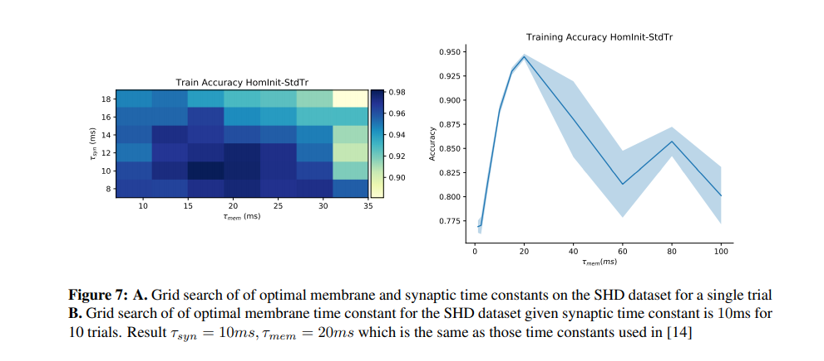
Time scale heterogeneity improves learning on tasks with rich temporal structure

Slide 17
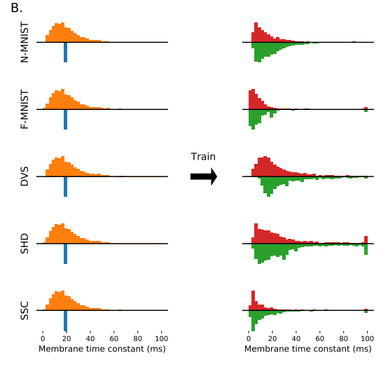

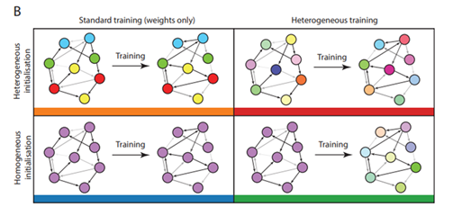
For standard training, the left graph remains as it is.

Slide 18
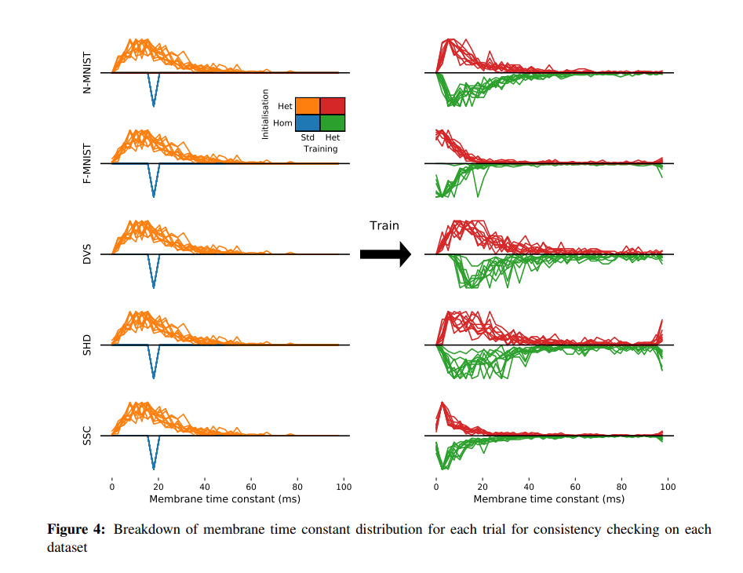

Slide 19
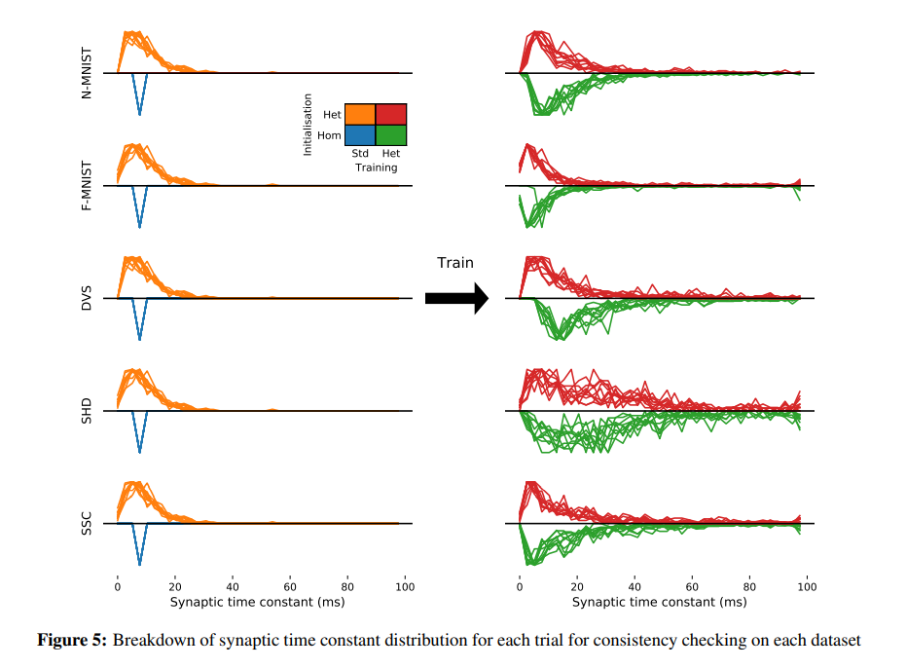

Slide 20
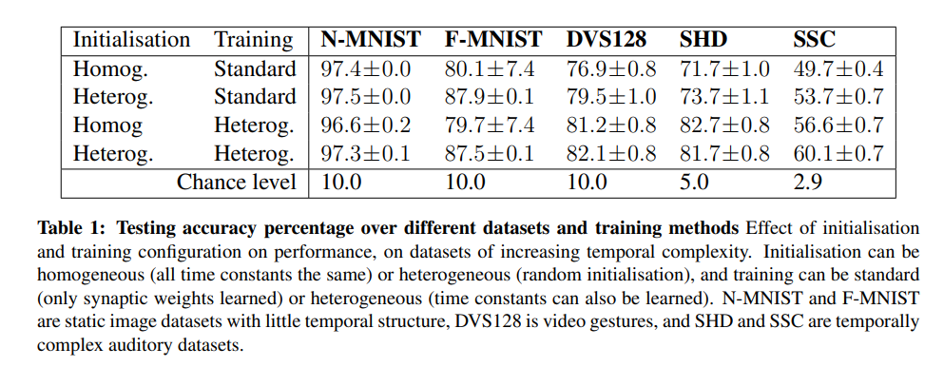
Time scale heterogeneity improves learning on tasks with rich temporal structure
chance levels? - the accuracy that will be reached when constantly predicting the majority class

Slide 21
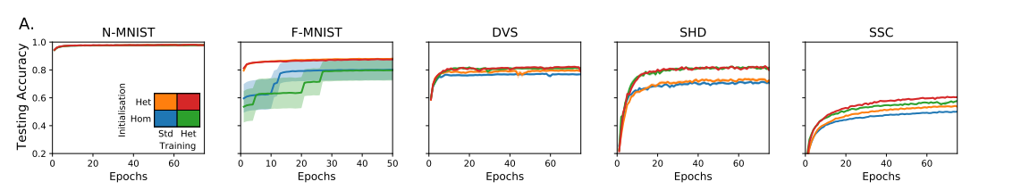
Time scale heterogeneity improves learning on tasks with rich temporal structure

Slide 22
Time scale heterogeneity improves learning on tasks with rich temporal structure
Introducing heterogeneity allows for a large increase in performance at the cost of only a very small increase in the number of parameters (0.23% for SHD, because the vast majority of parameters are synaptic weights), and without using any additional neurons or synapses.
It is a computationally efficient strategy of interest to neuromorphic computing (use of very-large-scale integration (VLSI) systems containing electronic analog circuits to mimic neuro-biological architectures present in the nervous system), because adding heterogeneity adds O(n) to memory use and computation time, while adding more neurons adds O(n²).

Slide 23
Time scale heterogeneity improves learning on tasks with rich temporal structure
Neftci et al. obtained a performance of 83.2% on the SHD dataset without heterogeneity using 1024 neurons and data augmentation technique.
The heterogeneity model obtained 82.7% using 128 neurons and no data augmentation.
Why study smaller networks?
systematically investigate the effect of different training regimes, and current limitations of surrogate gradient descent mean
with larger numbers of neurons, performance even without heterogeneity approaches the ceiling on these tasks making it more difficult to see the effect of different architectures.

Slide 24
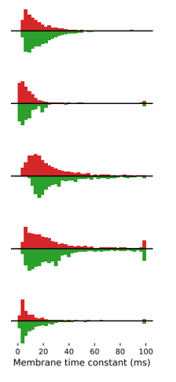
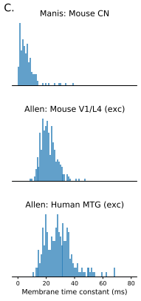
Predicted time constant distributions match experimental data
Experimentally observed distributions of time constants for (top to bottom): mouse cochlear nucleus, multiple cell types (172 cells); mouse V1 layer 4, spiny (putatively excitatory) cells (164 cells); human middle temporal gyrus, spiny cells (236 cells).

Slide 25
Predicted time constant distributions match experimental data
The parameters for these distributions are different for each animal and region, just as for different tasks in our simulations.
The distribution parameters are different for each cell type in the experimental data, a feature not replicated in our simulations as all cells are identical.
This suggests that introducing further diversity in terms of different cell types may lead to even better performance

Slide 26
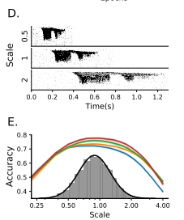
SPEECH LEARNING ACROSS TIME SCALES
Augmentation of the SHD spoken digits datasets to include faster or slower versions of the samples, multiplying all spike times by a temporal scale as an extremely simplified model that captures a part of the difficulty of this task.
During training, temporal scales were randomly selected from a distribution roughly matching human syllabic rate distributions.

Slide 27
ROBUSTNESS AGAINST MISTUNED LEARNING
Tested the hypothesis that heterogeneity can provide robustness with two experiments where the hyperparameters were mistuned, that is where the initial distributions and learning parameters were chosen to give the best performance for one distribution, but the actual training and testing is done on a different distribution.
First experiment: taking the augmented SHD spoken digits dataset from the previous section, selected the hyperparameters to give the best performance at a time scale of 1, then trained and tested the network at a different time scales.

Slide 28
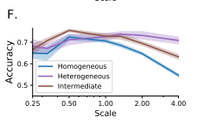
ROBUSTNESS AGAINST MISTUNED LEARNING
With a homogeneous or narrow heterogeneous initial distribution, performance falls off for time scales far from the optimal one, particularly for larger time scales (slower stimuli).
A wide heterogeneous initial distribution allows for good performance across all time scales tested, at the cost of slightly lower peak performance at the best time scale.
All the bars refer to the type of initialization, standard training was used to train the network. (time constant learning would negate the effect of mistuning)

Slide 29
ROBUSTNESS AGAINST MISTUNED LEARNING
Second experiment: FORCE training of spiking neural networks. This method does not allow for heterogeneous training (tuning time constants), so the only testing was the role of untrained heterogeneous neuron parameters.
Three configurations:
fully homogeneous (single 20ms time constant as in the original paper);
intermediate (each neuron randomly assigned a fixed fast 20ms or slow 100ms time constant);
or fully heterogeneous (each neuron randomly assigned a time constant drawn from a gamma distribution)

Slide 30
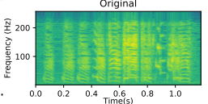
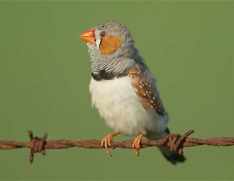
ROBUSTNESS AGAINST MISTUNED LEARNING
Aim: replay a learned signal, in this case a recording of a zebra finch call. The network has to learn to reproduce this spectrogram

Slide 31
ROBUSTNESS AGAINST MISTUNED LEARNING
[Nicola, W. & Clopath, C. Supervised learning in spiking neural networks with FORCE training. Nature Communications 8, 1–15 (2017).]
FORCE training is reminiscent of how songbirds learn their stereotypical learned songs. Juvenile songbirds are typically presented with a species specific song or repertoire of songs from their parents or other members of their species. These birds internalize the original template song and subsequently use it as an error signal for their own vocalization. Our model reproduced the singing behavior of songbirds with FORCE training as the error correction mechanism. The song spectrogram were accurately reproduced after FORCE training.

Slide 32
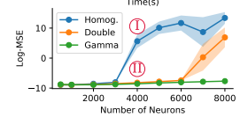
ROBUSTNESS AGAINST MISTUNED LEARNING
G and Q were the hyperparameters that effected the network performance predominantly.
Tuned these hyperparameters for a network of a fixed size (N = 1000 neurons) and ran the training and testing for networks of different sizes

Slide 33
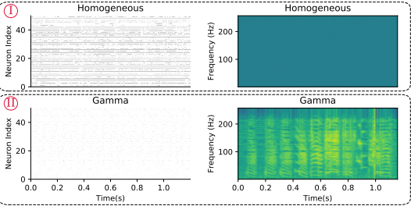
ROBUSTNESS AGAINST MISTUNED LEARNING

Slide 34
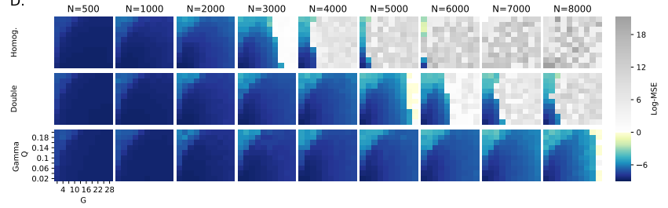
ROBUSTNESS AGAINST MISTUNED LEARNING

Slide 35
Discussion
Large improvement in tasks with richer intrinsic temporal structure
Learning was more robust, in that the networks were able to learn across a range of different environments, and when the hyperparameters of learning were mistuned.
A consistent distribution of time constants was found, akin to a log normal or gamma distribution, and this qualitatively matched time constants measured in experimental data.
Adding heterogeneity to the neuron model adds an additional time and memory cost of only O(n), while adding more neurons has a cost of O(n² )

Slide 36
Discussion
Tested the effect of introducing heterogeneity of other neuron parameters, such as the firing threshold and reset potential, but found that it made no appreciable difference. This was because for the current model, changing these is almost equivalent to a simple scaling of the membrane potential variable.

Slide 37
Discussion
The best performance could be found by tuning the distribution of time constants to match the task.
But without a more detailed model of these specific brain regions and the tasks they solve, it is difficult to conclude whether or not the precise distributions observed are tuned to those tasks or not, and indeed having a less precisely tuned distribution may lead to greater robustness in uncertain environments.

